Slide 1
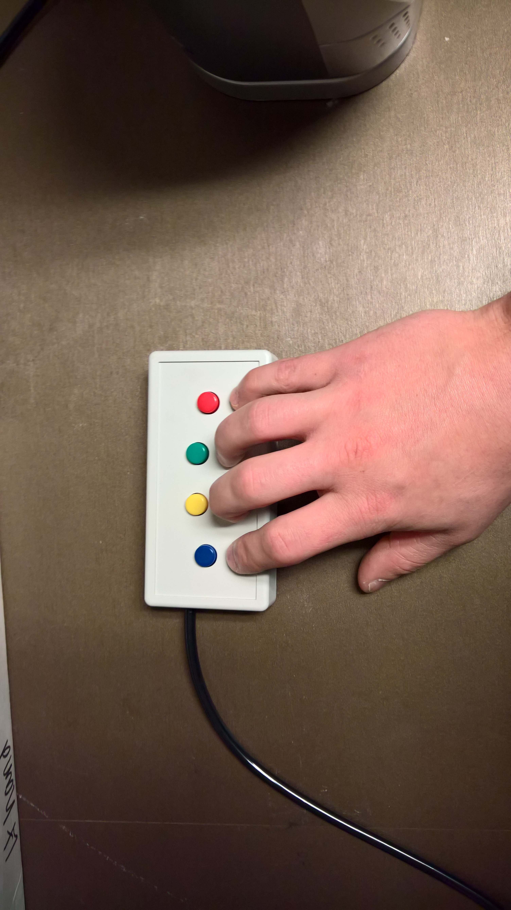
You will be using a button box like the one shown to make responses while you are in the scanner. Place your hand so that you can press one button with each finger.
Please tell the experimenter if you have any questions about how to use the button box.
1
2
3
4
ONE
PRESS THE ONE BUTTON TO CONTINUE

Slide 2
Picture Task
ONE
PRESS THE ONE BUTTON TO CONTINUE
Notes:
Inside the scanner

Slide 3
For this task, you will see a series of images.
Please attend to them carefully.
ONE
PRESS THE ONE BUTTON TO CONTINUE

Slide 4
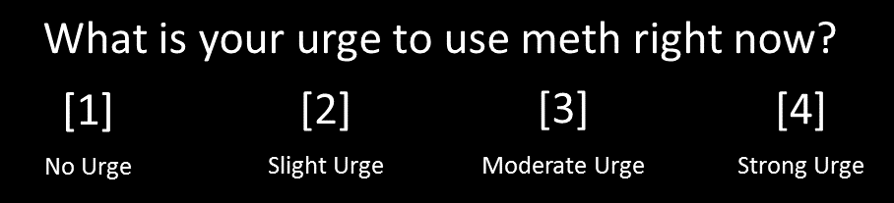
At times, you will be asked to rate your level of craving by seeing the message below. Use the button box to make your selection as shown. If you make a mistake, you can correct your selection by pressing another button.
ONE
PRESS THE ONE BUTTON TO CONTINUE

Slide 5
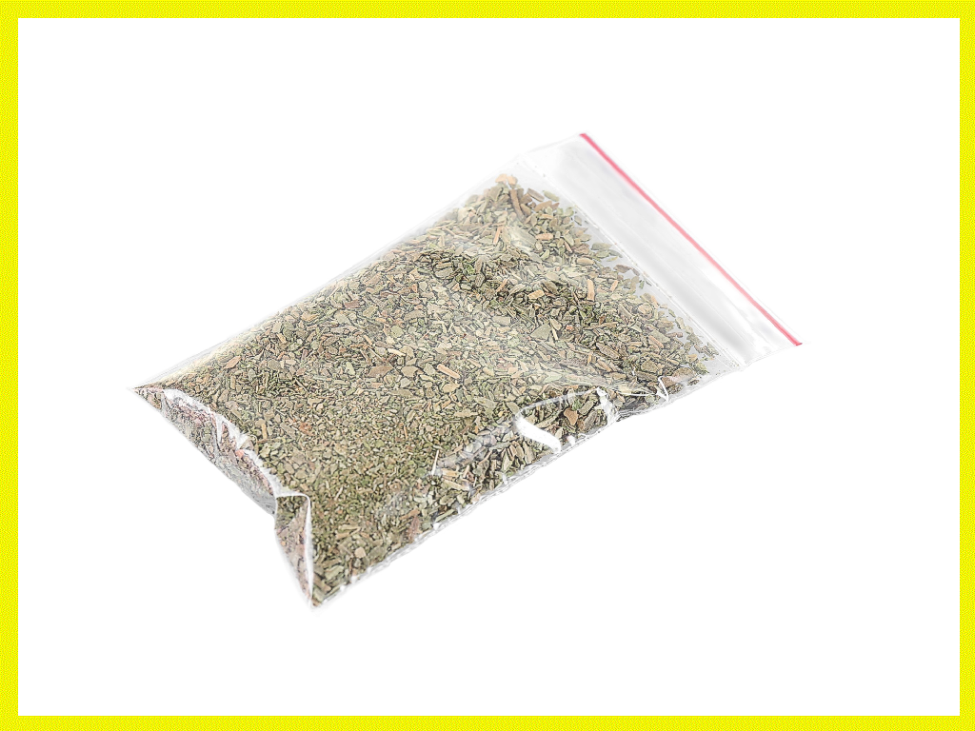
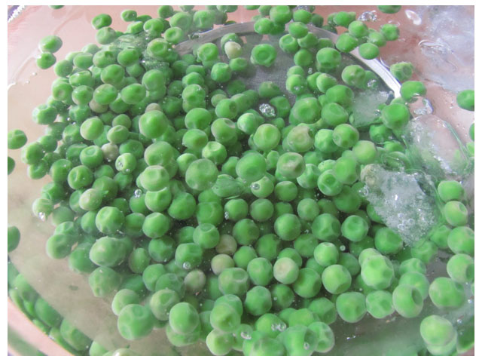
At times, a yellow border will appear around one of the images, as shown. When this happens, press any button to make the border disappear.
ONE
PRESS THE ONE BUTTON TO CONTINUE

Slide 6
Some of the pictures will be related to methamphetamine use. This may induce “drug craving” inside you. This is a normal response.
Please do not try to avoid or suppress your feelings when you see the pictures.
Now you will complete a practice session. Please let the experimenter know if you have any questions
ONE
PRESS THE ONE BUTTON TO CONTINUE

Slide 7
Press the ONE button when you are ready to begin
ONE
PRESS THE ONE BUTTON TO CONTINUE
Notes:
Inside the scanner

Slide 8
Rest
ONE
PRESS THE ONE BUTTON TO CONTINUE
Notes:
Inside the scanner

Slide 9
For this scan, you will see a “+” in the center of the screen.
Focus on the “+”, clear your mind and try not to think of anything in particular.
ONE
PRESS THE ONE BUTTON TO CONTINUE
Notes:
For inside the scanner.
What happens when they press enter?

Slide 10
IMPORTANT Please stay as STILL as possible during the scan. Press the ONE button when you are ready to begin
ONE
PRESS THE ONE BUTTON TO CONTINUE
Notes:
Inside the scanner

Slide 11
Please press the buttons in order:
1-2-3-4
1
2
3
4
For Examiner: PRESS z TO MOVE ON

Slide 12
Picture Task
ONE
PRESS THE ONE BUTTON TO CONTINUE
Notes:
Inside the scanner

Slide 13
Now you will complete the picture task. Please use the button box to make ratings as shown.
ONE
PRESS THE ONE BUTTON TO CONTINUE

Slide 14
Press any button when the image has a yellow border.
ONE
PRESS THE ONE BUTTON TO CONTINUE

Slide 15
Remember, some images will be related to methamphetamine use and may induce “drug craving” inside you.
This is a normal response and we ask you to focus on the images and try not to suppress or avoid your feelings.
Let your brain respond to them normally.
ONE
PRESS THE ONE BUTTON TO CONTINUE

Slide 16
IMPORTANT Please stay as STILL as possible during the scan. Press the ONE button when you are ready to begin
ONE
PRESS THE ONE BUTTON TO CONTINUE
Notes:
Inside the scanner

Slide 17

You will be using a button box like the one shown to make responses while you are in the scanner. Place your hand so that you can press one button with each finger.
Please tell the experimenter if you have any questions about how to use the button box.
1
2
3
4
FOUR
PRESS THE FOUR BUTTON TO CONTINUE

Slide 18
Picture Task
FOUR
PRESS THE FOUR BUTTON TO CONTINUE
Notes:
Inside the scanner

Slide 19
For this task, you will see a series of images.
Please attend to them carefully.
FOUR
PRESS THE FOUR BUTTON TO CONTINUE

Slide 20
At times, you will be asked to rate your level of craving by seeing the message below. Use the button box to make your selection as shown. If you make a mistake, you can correct your selection by pressing another button.
FOUR
PRESS THE FOUR BUTTON TO CONTINUE

Slide 21
At times, a yellow border will appear around one of the images, as shown. When this happens, press any button to make the border disappear.
FOUR
PRESS THE FOUR BUTTON TO CONTINUE

Slide 22
Some of the pictures will be related to methamphetamine use. This may induce “drug craving” inside you. This is a normal response.
Please do not try to avoid or suppress your feelings when you see the pictures.
Now you will complete a practice session. Please let the experimenter know if you have any questions
FOUR
PRESS THE FOUR BUTTON TO CONTINUE

Slide 23
Press the FOUR button when you are ready to begin
FOUR
PRESS THE FOUR BUTTON TO CONTINUE
Notes:
Inside the scanner

Slide 24
Rest
FOUR
PRESS THE FOUR BUTTON TO CONTINUE
Notes:
Inside the scanner

Slide 25
For this scan, you will see a “+” in the center of the screen.
Focus on the “+”, clear your mind and try not to think of anything in particular.
FOUR
PRESS THE FOUR BUTTON TO CONTINUE
Notes:
For inside the scanner.
What happens when they press enter?

Slide 26
IMPORTANT Please stay as STILL as possible during the scan. Press the FOUR button when you are ready to begin
FOUR
PRESS THE FOUR BUTTON TO CONTINUE
Notes:
Inside the scanner

Slide 27
Please press the buttons in order:
4-3-2-1
1
2
3
4
For Examiner: PRESS z TO MOVE ON

Slide 28
Picture Task
FOUR
PRESS THE FOUR BUTTON TO CONTINUE
Notes:
Inside the scanner

Slide 29
Now you will complete the picture task. Please use the button box to make ratings as shown.
FOUR
PRESS THE FOUR BUTTON TO CONTINUE

Slide 30
Press any button when the image has a yellow border.
FOUR
PRESS THE FOUR BUTTON TO CONTINUE

Slide 31
Remember, some images will be related to methamphetamine use and may induce “drug craving” inside you.
This is a normal response and we ask you to focus on the images and try not to suppress or avoid your feelings.
Let your brain respond to them normally.
FOUR
PRESS THE FOUR BUTTON TO CONTINUE

Slide 32
IMPORTANT Please stay as STILL as possible during the scan. Press the FOUR button when you are ready to begin
FOUR
PRESS THE FOUR BUTTON TO CONTINUE
Notes:
Inside the scanner

Slide 33
Please press the 1 button
1
2
3
4
PRESS 1 TO MOVE ON

Slide 34
Please press the 2 button
1
2
3
4
PRESS 2 TO MOVE ON

Slide 35
Please press the 3 button
1
2
3
4
PRESS 3 TO MOVE ON

Slide 36
Please press the 4 button
1
2
3
4
PRESS 4 TO MOVE ON

Slide 37
Please press the 4 button
1
2
3
4
PRESS 4 TO MOVE ON

Slide 38
Please press the 3 button
1
2
3
4
PRESS 3 TO MOVE ON

Slide 39
Please press the 2 button
1
2
3
4
PRESS 2 TO MOVE ON

Slide 40
Please press the 1 button
1
2
3
4
PRESS 1 TO MOVE ON

